Slide 1
Drug Safety Labeling: A Legal Perspective
FDA Regulatory and Compliance Symposium Aug 21-24, 2007
Dave Ceryak, Esq.
Assistant General Counsel, Regulatory Affairs
Eli Lilly and Company
DVC
August 21-24, 2007
Company Confidential
Copyright © 2000 Eli Lilly and Company

Slide 2

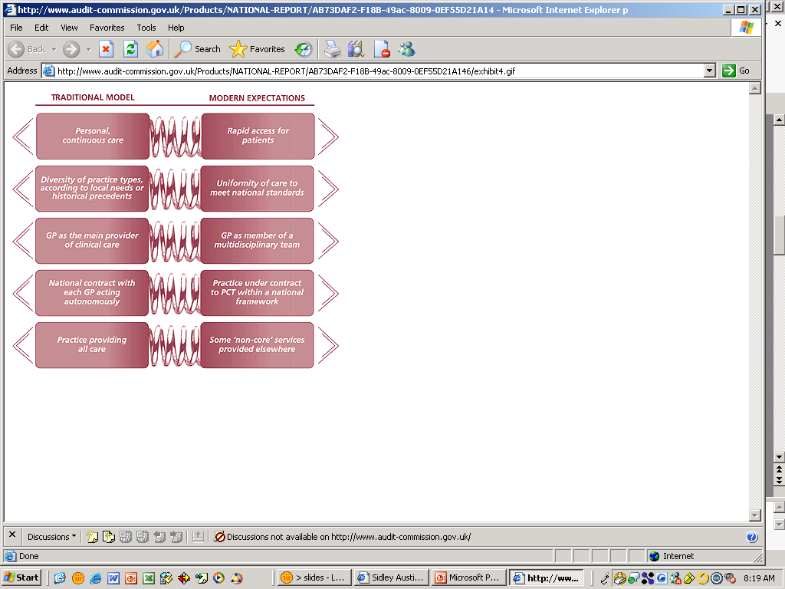
How Are State Law Requirements Viewed In Relation to the Content of the Product Label?
Labeling
Requirements
OR
DVC
August 21-24, 2007
Company Confidential
Copyright © 2000 Eli Lilly and Company

Slide 3
Opposing Forces?
State Law/Product Liability
Federal Laws and Regs
All-inclusive Warnings
Streamlined Warnings
Paper Records
Electronic Labels
Duty to Warn Consumers
Duty to Warn Physicians
Signal Disclosures = Admissions
Unconfirmed Signal Communications

Slide 4
FDA’s Legal Authority Over the Product Label
Assessment and approval of drug labeling are inherent in FDA’s authority to determine safety and efficacy.
  FDA shall refuse NDA approval if investigations do not show “...whether or not such drug is safe for use under the conditions prescribed, recommended, or suggested in the proposed labeling thereof…” 21 USC 355(d)
  Drug label must
    “…contain a summary of the essential scientific information needed for the safe and effective use of the drug.”
    “…be informative and accurate and neither promotional in tone or false or misleading in any particular.”
    be updated “when new information becomes available that causes the labeling to become inaccurate, false or misleading.” 21 CFR 201.56
FDA’s Enforcement Authority for Marketed Drugs
  Misbranding: not “false or misleading” under 21 USC 321(n), 352, 355(d)
  Withdrawal of NDA approval under 21 USC 355(e)
  Pending Legislation
DVC
August 21-24, 2007
Company Confidential
Copyright © 2000 Eli Lilly and Company

Slide 5
Post-marketing Safety Label Changes
Prior Approval Supplement: 21 CFR 314.70(b)(2)(v)(A)
Changes Being Effected Supplement (“CBE”)
  21 CFR 314.70(c)(6)(iii)
  includes addition or strengthening of safety information
  “……holder of an approved application may commence distribution of the drug product involved upon receipt by the agency of a supplement for the change.”
  Some view CBEs as the basis for:
Labeling
Requirements
DVC
August 21-24, 2007
Company Confidential
Copyright © 2000 Eli Lilly and Company

Slide 6
Post-marketing Safety Label Changes (cont’d)
CBEs remain subject to FDA approval or denial
CBE label changes remain subject to misbranding actions under 21 USC 352(a)
Exception to CBE regulations (“….changes to the information required in 210.57(a)…”) refers to PLR Highlights section
Pending Legislation
DVC
August 21-24, 2007
Company Confidential
Copyright © 2000 Eli Lilly and Company

Slide 7
Product Liability “101”
Most cases are based on “failure to warn” claims under state law
  Omission of risk information
  Inclusion of misleading statement
“Learned Intermediary”: pharmaceutical manufacturers can satisfy duty to warn by informing physicians via the product label
  Consumers cannot access products directly
  Complexity of risk information and benefit-risk assessment
Preemption: Constitutional doctrine that federal law prevails over state law in the case of inconsistencies
  Federal law is Food, Drug and Cosmetic Act as administered by FDA
  State court makes a determination of adequacy of warnings under state law
  Point of contention: Is an FDA-approved label a “ceiling,” or just a “floor?”
DVC
August 21-24, 2007
Company Confidential
Copyright © 2000 Eli Lilly and Company

Slide 8
Opposing Forces?
Product Liability
Federal Laws and Regs
All-inclusive Warnings
Streamlined Warnings
Paper Records
Electronic Labels
Duty to Warn Consumers
Duty to Warn Physicians
Signal Disclosures = Admissions
Unconfirmed Signal Communications

Slide 9
Content of the Label
All-inclusive Warnings
Streamlined Warnings
DVC
August 21-24, 2007
Company Confidential
Copyright © 2000 Eli Lilly and Company

Slide 10
Physician Labeling Rule (PLR)
PLR: Final rule issued by FDA effective June 30, 2006 that revises regulations on the content and format of the drug label
  USPI divided into 3 main sections: Highlights; Table of Contents; Full Prescribing Information
  ½ page limit for Highlights unless FDA grants waiver
  Warnings and precautions collapsed
  Clarification regarding inclusion of terms in the Adverse Reactions section
  Rule and Guidance Documents available at www.fda.gov/cder/regulatory/physlabel/
DVC
August 21-24, 2007
Company Confidential
Copyright © 2000 Eli Lilly and Company

Slide 11
PLR: Product Liability Implications
Deciding What to Include in Highlights Section and when to seek waiver of ½ page limitation
  Example: Warnings/Precautions
FPI: 21 CFR 201.57(c)(6)
This section must describe clinically significant adverse reactions,…other potential safety hazards,…limitations in use imposed by them,… and steps that should be taken if they occur.
Highlights: 21 CFR 201.57(a)(10)
A concise summary of the most clinically significant information required under paragraph (c)(6) of this section…including information that would affect decisions about whether to prescribe a drug, recommendations for patient monitoring that are critical to safe use of the drug, and measures that can be taken to prevent or mitigate harm
DVC
August 21-24, 2007
Company Confidential
Copyright © 2000 Eli Lilly and Company

Slide 12
PLR: Product Liability Implications (cont’d)
Conversion of approved USPI to PLR format
  A. Exclusion of Safety Terms
  B. Consistency with Core Data Sheet, Previous Regulatory Discussion and Documentation
Proposed Rule: more narrow definition of ADR
  Existing:
    “…undesirable effect, reasonably associated with use of a drug…”
  Proposed:
    “…unintended response…for which there is a reasonable possibility that the product caused the response…”
Final Rule: Leave definition as is, “clarify intent”
    “...[existing] definition of adverse reaction….is appropriate for labeling, but [it] requires clarification…to minimize including information in labeling that does not help prescribers use the drug safely and effectively (i.e., adverse events that are not related to use of the drug)...”
DVC
August 21-24, 2007
Company Confidential
Copyright © 2000 Eli Lilly and Company

Slide 13
PLR: Product Liability Implications (cont’d)
“Adverse Events” versus “Adverse Reactions”
  Tables?
  Process considerations
Subsequent Label Updates: CBE or PAS?
  If label change impacts Highlights, it requires submission of a prior approval supplement. 314.70(b)(2)(v)(C) and (c)(6)(iii)
DVC
August 21-24, 2007
Company Confidential
Copyright © 2000 Eli Lilly and Company

Slide 14
Electronic Labels
Paper Records
Electronic Labels
DVC
August 21-24, 2007
Company Confidential
Copyright © 2000 Eli Lilly and Company

Slide 15
Structured Product Labeling (SPL)
Since 2005, FDA has required the content of labeling to be submitted in the SPL standard in order to support health information technology and eHR.
    21 CFR 314.50(1)
    Guidance for Industry: Providing Regulatory Submissions In Electronic Format – Content of Labeling (April 2005).
With PLR, content of USPI “Highlights” section required to be coded
    - Specified Coding Dictionaries
Labels in SPL format available on DailyMed (www.dailymed.nlm.nih.gov)
DVC
August 21-24, 2007
Company Confidential
Copyright © 2000 Eli Lilly and Company

Slide 16
eLabel: Product Liability Implications
Potential Differences Between Highlights in Written and SPL Formats
eHR Implications of Decisions to Exclude Information from Highlights
Additional Coding Step for Adverse Events May Require Additional Clinical Judgments
      MEDRA Label (PDF) SNOMED
DVC
August 21-24, 2007
Company Confidential
Copyright © 2000 Eli Lilly and Company

Slide 17
Duty to Warn....Whom?
Duty to Warn Consumers
Duty to Warn Physicians
DVC
August 21-24, 2007
Company Confidential
Copyright © 2000 Eli Lilly and Company

Slide 18

Flow of Product Information Via the “Learned Intermediary”
Sponsor
Reasonably Foreseeable Risks and
Adequate Directions for Safe Use
Healthcare Professional
Informed Consent for Treatment
Patient
DVC
August 21-24, 2007
Company Confidential
Copyright © 2000 Eli Lilly and Company

Slide 19
Duty to Warn…….Whom?
“Learned Intermediary” Principle Adopted by Courts and Built Into FDA’s Regulatory Structure:
    Drug labeling must include “…adequate information for its use…under which practitioners licensed by law to administer the drug can use the drug safely and for the purposes for which it is intended…” 21 CFR 201.100(d)(1)
Johnson and Johnson Corp. v. Karl: “…manufacturers of prescription drugs are subject to the same duty to warn consumers about the risks of their products as other manufacturers…” (emphasis added) (W. Va. June 27, 2007)
Role of Drug Information Targeted to Consumers?
  PPIs and MedGuides
  DTC Advertising
  Clinical Trial Results Databases
  FDA Web Site
  Implications for Product Liability and Labeling Practices
DVC
August 21-24, 2007
Company Confidential
Copyright © 2000 Eli Lilly and Company

Slide 20
Disclosure of Unconfirmed Safety Signals
Signal Disclosures = Admissions
Unconfirmed Signal Communications
DVC
August 21-24, 2007
Company Confidential
Copyright © 2000 Eli Lilly and Company

Slide 21
Disclosure of Unconfirmed Signals: Product Liability Implications
Communication of “Emerging” Drug Safety Information
  FDA Guidance: Drug Safety Information – FDA’s Communication to the Public (March, 2007)
  “Emerging” = potentially important drug safety issue that FDA is reviewing but “has not yet been fully analyzed or confirmed.”
Public Disclosure of CBEs
  FDA Draft Guidance: Public Availability of Labeling Changes in “Changes Being Effected” Supplements (September, 2006)
Pending Legislation
DVC
August 21-24, 2007
Company Confidential
Copyright © 2000 Eli Lilly and Company

Slide 22
Concluding Thoughts…..and Questions
DVC
August 21-24, 2007
Company Confidential
Copyright © 2000 Eli Lilly and Company

